Slide 1

Fight Club Game
Mostafa Amin - 181033
Abdelrahman Mohamed Mousa - 171015
Ahmed Mahrous - 181006

Slide 2
Fight Club Game
A game window will open and show your player object and the enemies, who should fight them. they are added to the server. The names of all entities are shown alongside their health point bars.

Slide 3
Can in Game
Move your character (to up, right, left and down) by keyboard arrows.
Attack an enemy and when Health bar reaches zero, the entity is killed and removed.
Chat the players in game to publish the text bubble you entered to all other players in the scene.

Slide 4
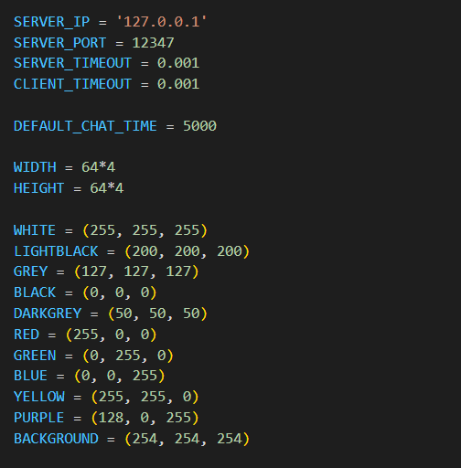
macros.py

Slide 5
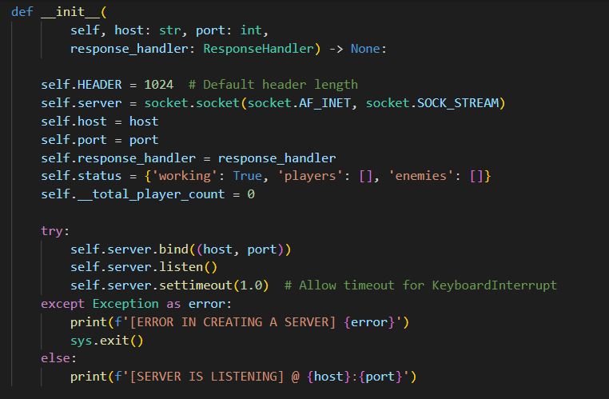
Server.py

Slide 6
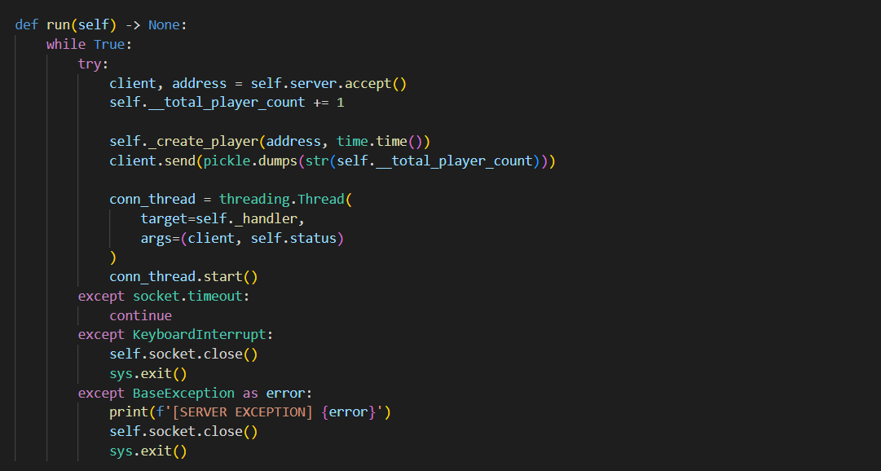
Server.py

Slide 7
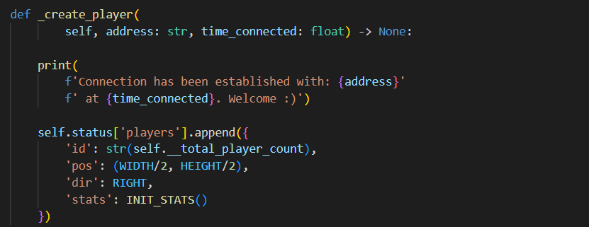
Server.py

Slide 8
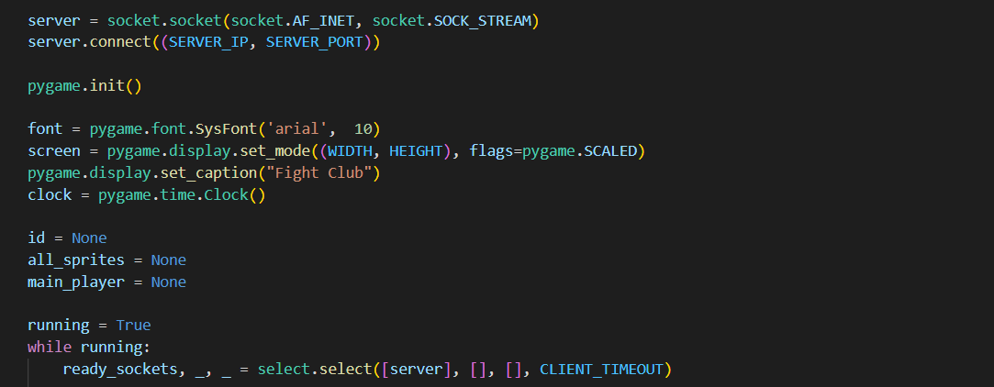
Client.py

Slide 9
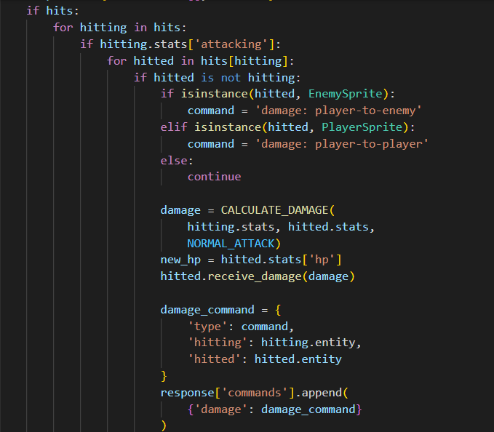
Client.py

Slide 10
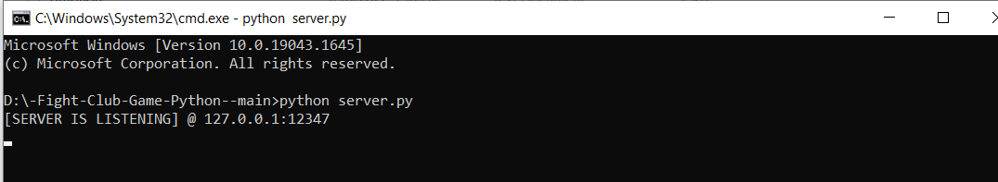
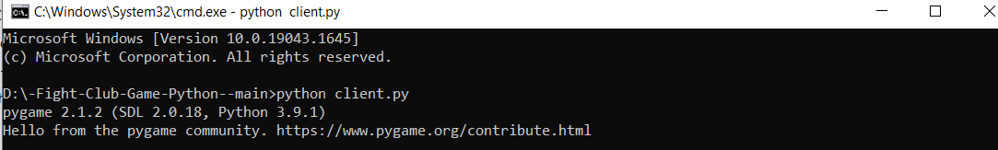
RUN

Slide 11
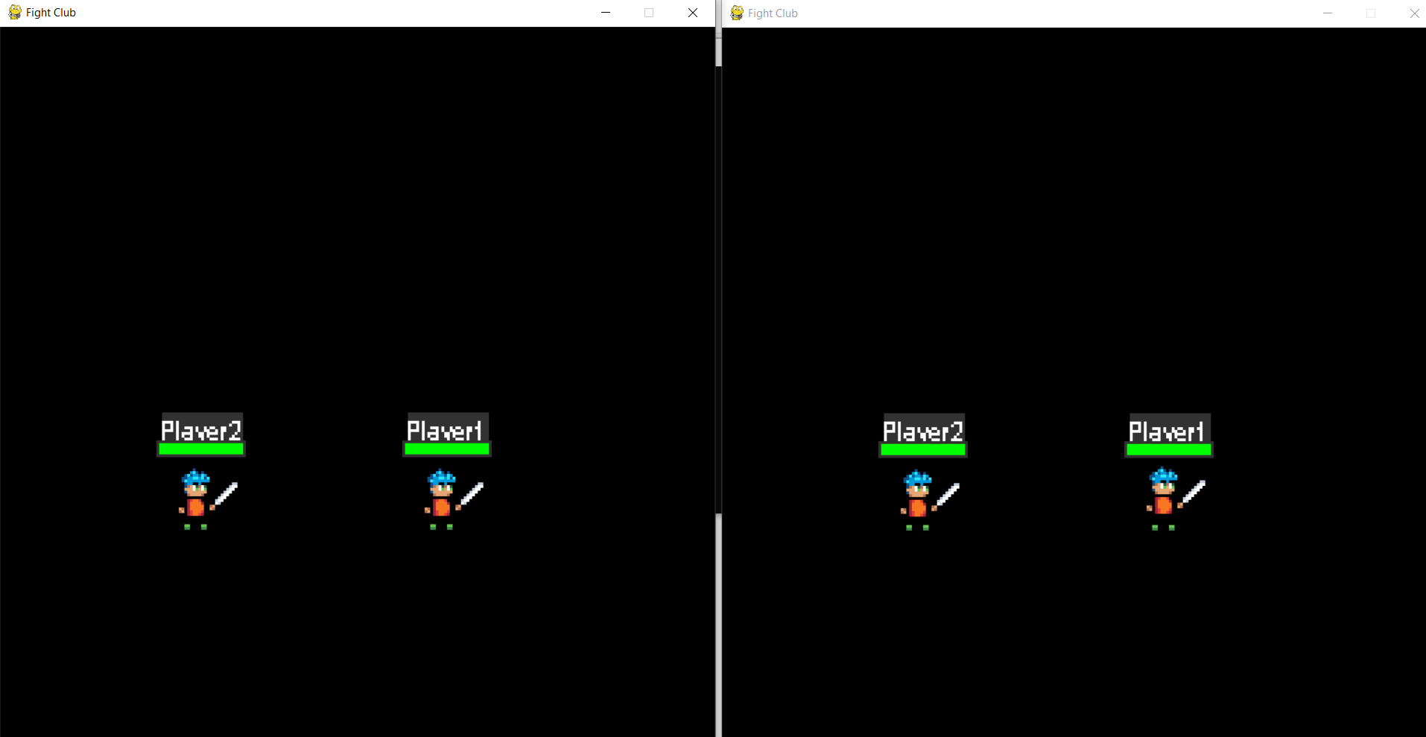
Client_1
Client_2

Slide 12
GitHub Link
https://github.com/AbdoMosa99/-Fight-Club-Game-Python-

Slide 13

Thank You

